Slide 1
Jobs and recreation
Arctic Canada and Zimbabwe

Slide 2
Jobs in Arctic Canada and zimbabwe

Slide 3
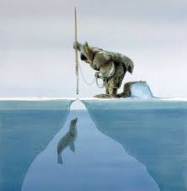
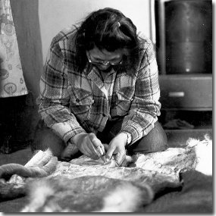
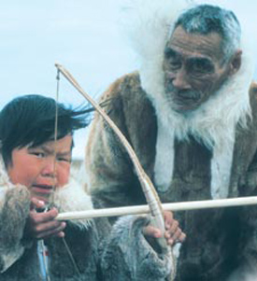
Jobs in the past – arctic canada
Men: spent most of their time hunting to provide food for their family. They also made their own weapons and tools, trained and cared for huskies and built igloos and sled.
Women: cleaned animal skins, made all clothing, melted ice for water, prepared meat for meals, cared for children, and kept seal oil lamp lit to warm the igloo.
Children: did not go to school, but did learn from their parents and grandparents. They needed to learn how to survive in the Arctic in cold weather and how to tell if the ice was safe to walk on.

Slide 4
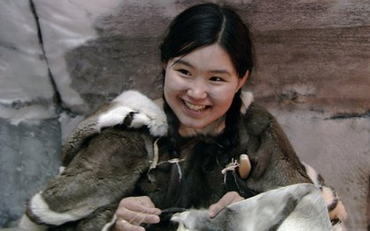
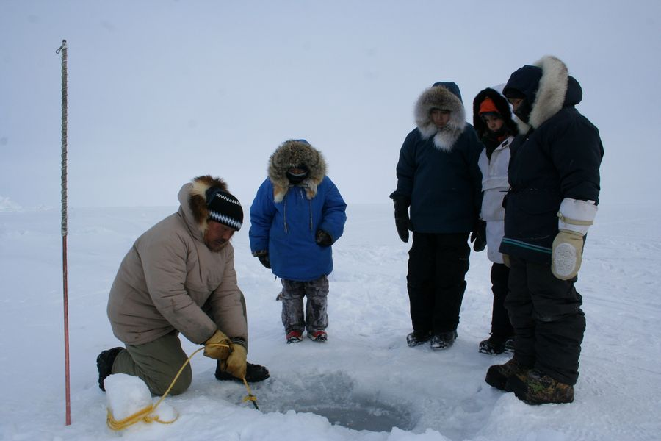
Jobs in the past – arctic canada
Boys: taught to find animals to hunt, how to hunt them, and how to train and handle sled dogs.
Girls: taught to prepare skins and furs for clothing, how to use an ulu to skin an animal and cut up meat, how to sew and make thread from sinew and needles from bones.
Oral History: children would hear stories from the elders about their ancestors and legends about spirits and animals.

Slide 5
Learning to fish
Each experience you have leads to learning.
In this video, a young boy learns to not only hunt, but how to prepare the food.
This child’s learning occurs not only in school, but at home and in his community.
https://www.youtube.com/watch?v=oDpGk9irmJg

Slide 6
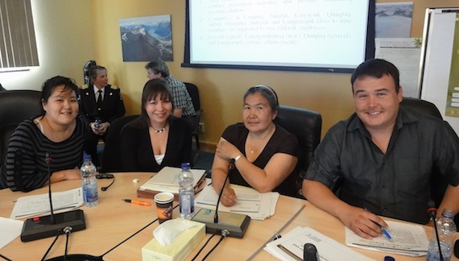
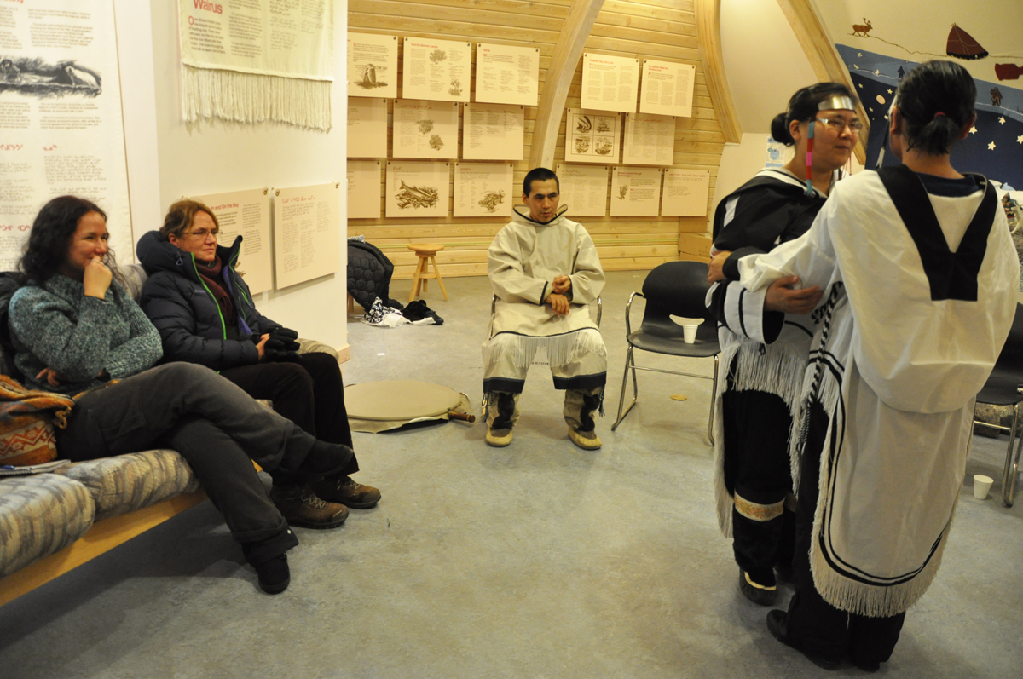
Jobs today – Arctic Canada
In remote areas (far from villages), Inuit still follow many of their traditional ways.
However, MOST Inuit now live in communities in permanent houses. This has caused changes to Inuit society.
They need to buy expensive fuel to heat homes.
They can buy food and clothing in stores.
These changes have made traditional life difficult, as all of these new conveniences require MONEY!
Today, to earn Money, many inuit work in stores, the tourism industry or other jobs within their community.

Slide 7
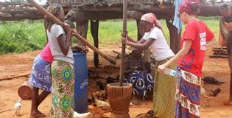
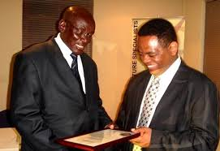
Jobs in Zimbabwe
Zimbabwe is country which has modern and traditional aspects.
For example, televisions are common within urban areas.
In rural areas, many people do not have running water or electricity.
In these villages, many people still live the same way as their ancestors used to.

Slide 8
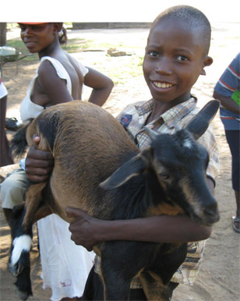
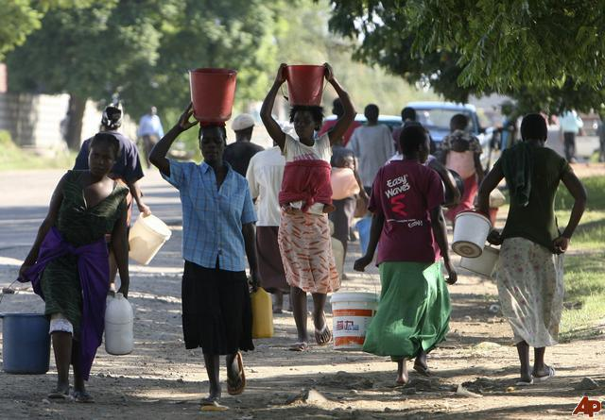
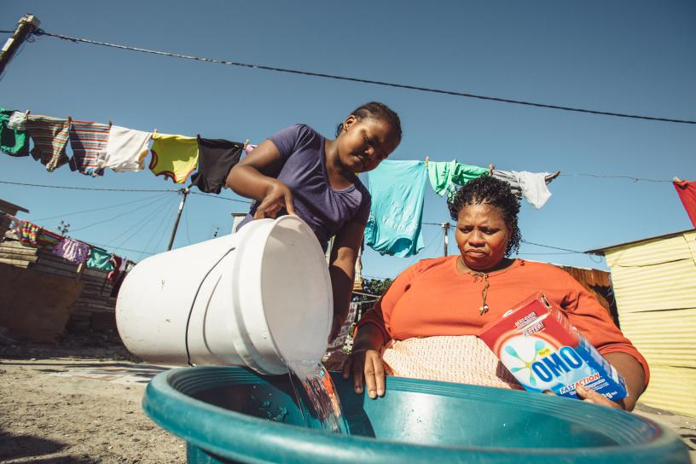
Jobs in Zimbabwe: Past and Present
In these rural villages, the community continues with past traditions to survive:
Men hunt and fish.
Women work in the gardens, grind corn into flour, cook and wash clothes
Boys watch over the goats and cows and water the garden.
Girls help their mothers with household chores and take care of babies. They also collect water.
Some men from rural villages will travel miles away from their homes to work in mines, on large farms, or jobs in the city. This means that they only come home on holidays and weekends.

Slide 9
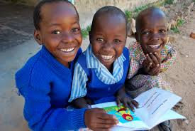
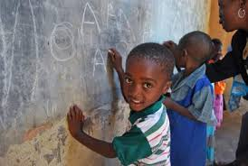
Jobs in Zimbabwe: Past and Present
Education: free for all and lasts nine years.
Some children walk a long way to attend school, or they take the bus into town for school and may only come home for weekends.
Not all children attend school.
In remote areas where people live in traditional ways, children learn from their parents how to work in the village (very much like early Inuit families.)

Slide 10
Class discussion question
Let’s compare!
Open your Social Studies notebook and glue in the worksheet given to you from your teacher.
Let’s examine chores and education that you would have in Hong Kong compared to children in Arctic Canada and Zimbabwe!
What is a chore?
a daily task that one must complete, especially those related to work in a household.
In the slides above, men and women, as well as boys and girls, had very different jobs. In Hong Kong, do we have this same divide? Are there traditional jobs for men and women?
https://www.youtube.com/watch?v=rpjmeyI2pfI

Slide 11
What is recreation?
Definition: activities done for fun when one is not working!
Why did we talk about jobs/chores and education?
Everyone does something simply for fun, even ADULTS, when NOT WORKING!
Education, as well as jobs/chores, have a specific purpose and is not considered recreation.
What we do for fun depends on our experiences, and many of our experiences are shaped by the environment around us!

Slide 12
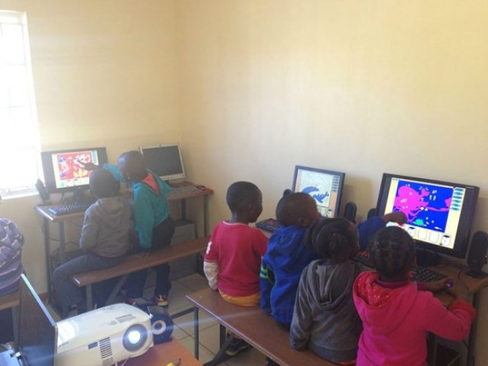
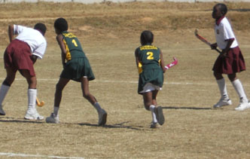
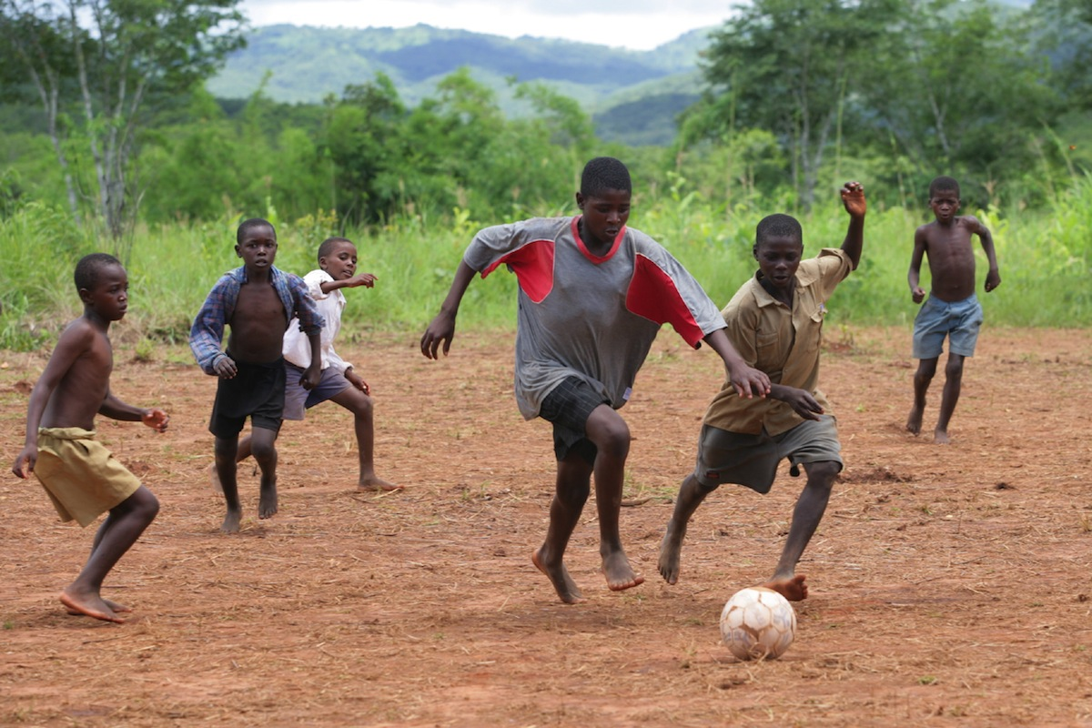
Recreation in Zimbabwe - urban
In Zimbabwe, we know there is a difference between rural and urban communities! This affects what we do for fun when we are not working (recreation).
In urban communities, we can find children doing very similar recreational activities to children here in Hong Kong.
Children and youth in Zimbabwe like to play on computers as well! They can usually have access to a computer at local community centres and schools.
Children play sports, like field hockey, in recreational and competitive leagues both at school and after in leagues. This game can be played with materials from within the community and anywhere there is a flat field.
Soccer is by far the most popular sport in Zimbabwe. However, Rugby and Cricket have a large number of players as well! Soccer is a relatively cheap sport to play and can be played anywhere!

Slide 13
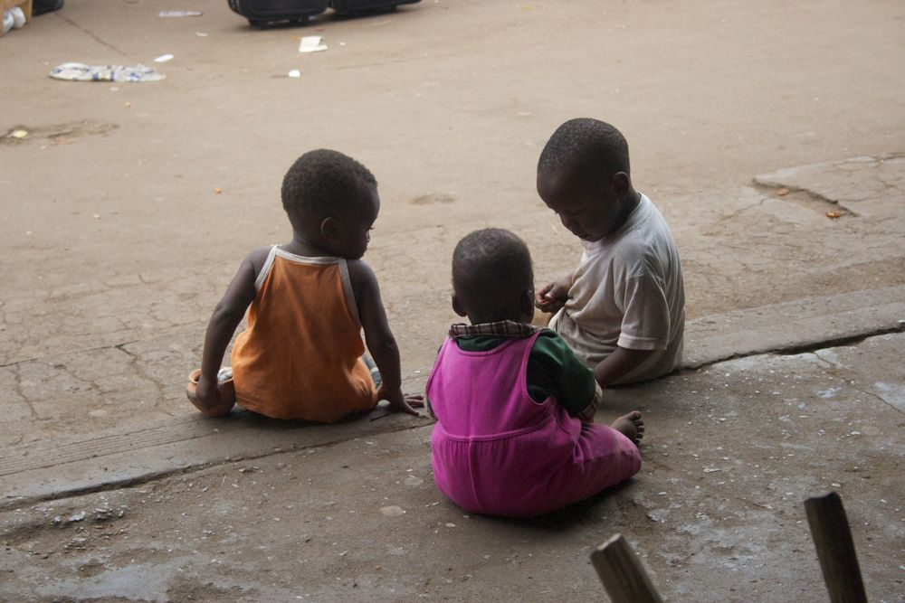
Recreation in Zimbabwe - Rural
In Zimbabwe, we know there is a difference between rural and urban communities! This affects what we do for fun when we are not working (recreation).
In rural communities, we can find children playing more traditional games focused upon less (no electricity)
DANCE and SONG are two of the most common forms of recreation within these communities. It takes relatively few resources and can be done for entertainment even while working. Check out the traditional dance below!
Mahumbwe: this is a game in which they play “house.” Children pretend to be different roles (mother, father, etc.). Playing house is a common game amongst young children in many global communities.
Even in rural communities, soccer is a VERY popular sport! Children can make balls from animal skin stuffed with vegetation. It is rare to walk into a community without a few children who play soccer for fun.
https://www.youtube.com/watch?v=1uVsONRO-GE

Slide 14
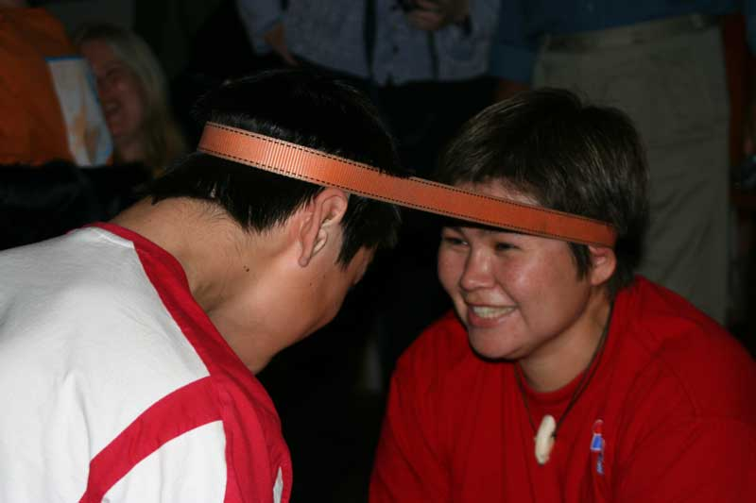
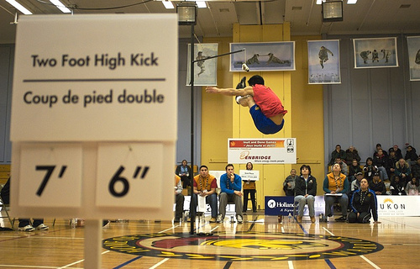
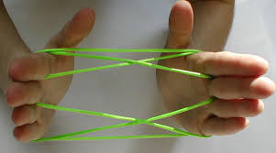
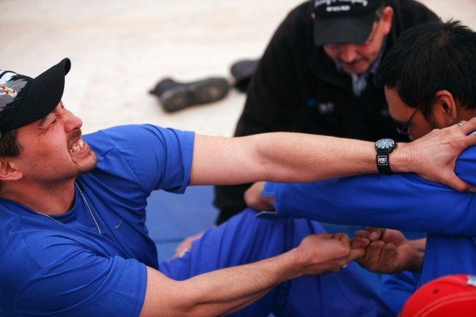
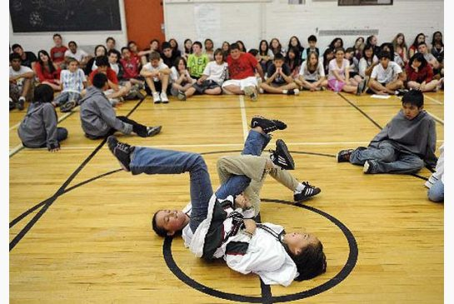
Recreation in arctic Canada and zimbabwe

Slide 15
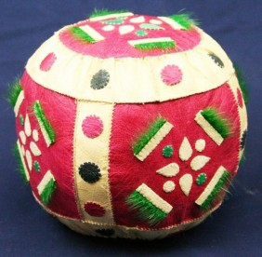
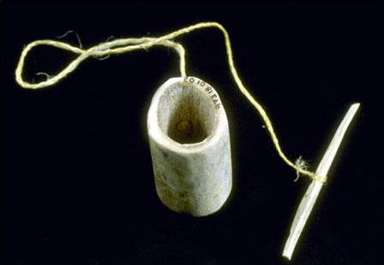
Traditional Recreation
In the past, men and women did not have a lot of time for recreation.They worked very hard to simply survive by providing food, clothing and shelter for their family.
However, when it was too cold to hunt, they stayed inside until the weather changed. To pass the time, games were played.
Ajarraaq: This is a string game. The Inuit used a thin piece of sealskin instead of string and made different shapes in much the same way as cat’s cradle is played. They often sang and told stories to go along with their play.
Ajagaq: This game used a ring made of bone or a hare skull, a sinew string, and a bone pin. Children tried to catch the bone ring on the pin.
Children would also play ball with each other. They would have a ball made of seal skin stuffed with moss to play with.

Slide 16
Traditional Inuit Recreation
Today, many of the following traditional games/sports are still played! They even have Arctic Games in which people from across Arctic Canada come together to play one another! Sports and Recreation are a great way to build a sense of community!
Finger Pulling: This is actually a Dene game (another group of people from the north). This game was created to first help build strength for the fishing season.
Leg Wrestling: In this game, two competitors lay on their back and try to flip the other member over by pushing their leg down.
Head Pull: In this game, two competitors try to have the other competitor cross a line. You try to the pull competitor to your side.

Slide 17
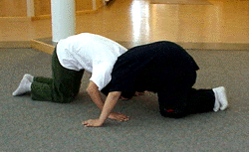
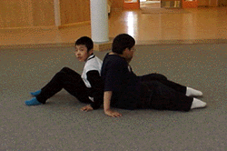
Present Inuit Recreation
Today, many of the following traditional games/sports are still played! They even have Arctic Games in which people from across Arctic Canada come together to play one another! Sports and Recreation are a great way to build a sense of community!
Two-Foot High Kick: To win this game, you must jump with both feet together to hit a ball or target lifted high in the air!
Musk Ox Push: With both players on their hands and knees, and heads bent down against each others' shoulders, they attempt to push each other forward out of a designated area. Hands must be kept on the floor
Back Push: Sit on the floor with your back against your partner. With hands and feet on the floor, try to push your partner backwards.

Slide 18
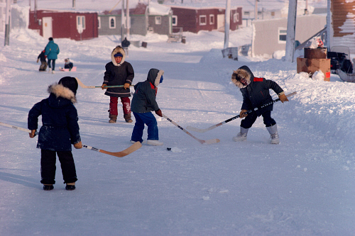
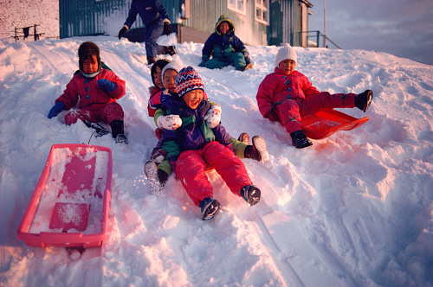
Present Inuit Recreation
Today, the Inuit people play various activities, games and sports within their community. Hockey is the most popular sport, but you can also find people playing and watching baseball and basketball. Children also like to play on the computer and with their video games.
Inuit children and youth like to play on computers as well! They can usually have access to a computer at local community centres and schools.
Tobaggoning (seen above), as well as snowman making and snowball fights, are common recreational activities for children given the cold temperatures and snow.
Hockey is the most popular sport as it can be played in an arena, but it can also be played on the ice outside.

Slide 19
WATCH THIS!
https://www.youtube.com/watch?v=7T85r3cTjg0

Slide 20
YOUR TURN! Let’s make an ajagaq! Listen to your teacher and follow along!

Slide 21
Materials needed (cup has a hole)

Slide 22
First put the string through the hole.

Slide 23
Cross the string over.

Slide 24
Take the end and push it through the loop. Create another loop and repeat.

Slide 25
Pull on the string to tighten the knot.

Slide 26
Part 1 is now done!

Slide 27
Loop a string around the end of your pencil.

Slide 28
Push the end of the string through the loop.

Slide 29
Pull the string to tighten.

Slide 30
Create another loop.

Slide 31
Push the string through the loop.

Slide 32
Pull the string tight to complete the knot!

Slide 33
Now play with your ajagaq!

