Slide 1
Food in Global communities
Hong Kong, Zimbabwe, and Arctic Canada

Slide 2
Let’s play a game…and learn!
You are going to be asked different questions.
There are four possible answers to each question. You must CHOOSE ONE!
To make your choice, you have to go to the corner which the picture belongs to.
If you’re incorrect, go to the picture that you think is correct!
Let’s practice with something easy!
Remember, if wrong, move to the one you think is correct!

Slide 3
What is Mr. Pakosh’s Favourite colour?
Blue is a great colour! However, it isn’t Mr. Pakosh’s favourite! Try again!
Mr. Pakosh loves the colour red, but it’s not
his favourite.
Try again!
<- Blue
<- Red
Orange is a great colour! However, it isn’t Mr. Pakosh’s favourite! Try again!
Great job! GREEN IS CORRECT! Now, let’s learn about food in Global Communities!
<- Orange
<- Green

Slide 4
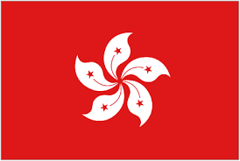
HONG KONG

Slide 5
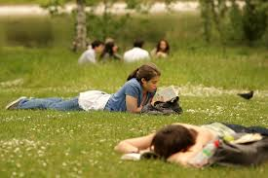
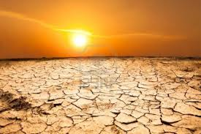
Which photo best describes hong kong temperature?
It never snows in Hong Kong! It definitely isn’t this cold!
It is sometimes cool, but usually heats up during the day! Guess again!
← Freezing
← Cool
It does feel like your melting sometimes, but is never too hot to make a desert!
← Warm
← VERY HOT!

Slide 6
Hong Kong is warm!
Why is Hong Kong warm?
Hong Kong is close to the equator which means that it receives more sunlight and warmer temperatures in comparison to other communities farther north.
Why is temperature important to food?
Temperature helps decide what food can be grown (farms) in one area. With warm temperatures, it is possible to grow many different types of food, like rice, fruits, and vegetables. It is also good for keeping animals for food, like chickens, sheep and cows.

Slide 7
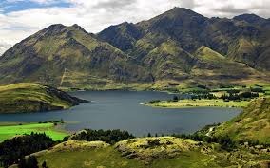
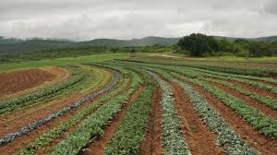
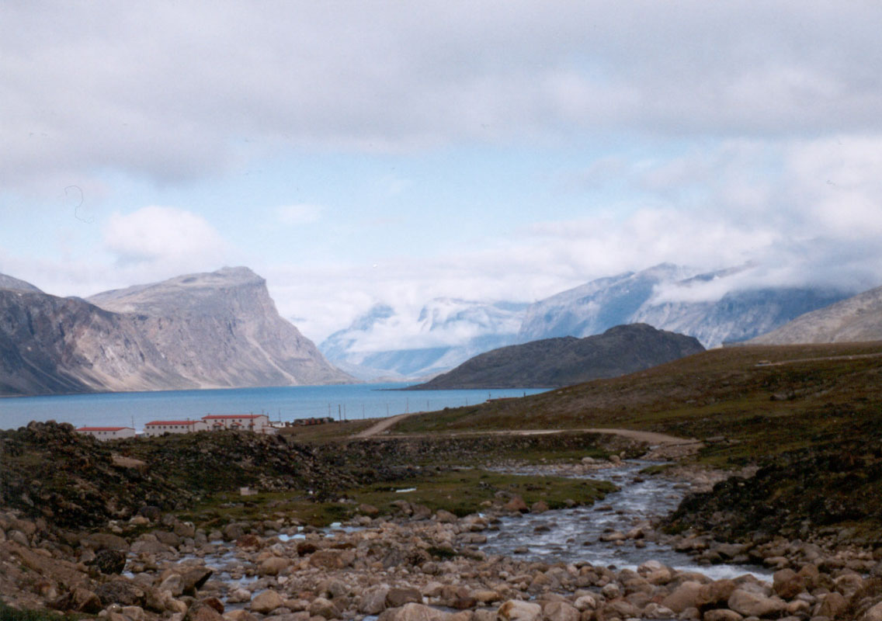
Which photo best shows Hong Kong’s land?
Of course! Hong Kong is very mountainous! This makes farming difficult!
Nope! Hong Kong isn’t very flat. It also doesn’t have a lot of space for farming.
← Mountains
← Farmland
Getting close! We live in a warm and humid place, but we still live on solid ground…unlike wetlands!
In the Tundra, it is difficult for plants to grow because of the cold. Hong Kong is not cold, and it has a lot of plants!
← Wetlands
← Tundra

Slide 8
Hong Kong is Mountainous!
Why is land important to food?
The land on which we live helps decide what food can be grown. In a mountainous area, there is some soil to grow plants but not enough for a farm. The angle of the mountain would also make farming difficult. Hong Kong’s mountains take up a lot of space, which means very little space to grow food for everyone who lives here!

Slide 9
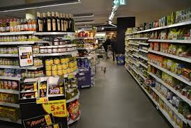
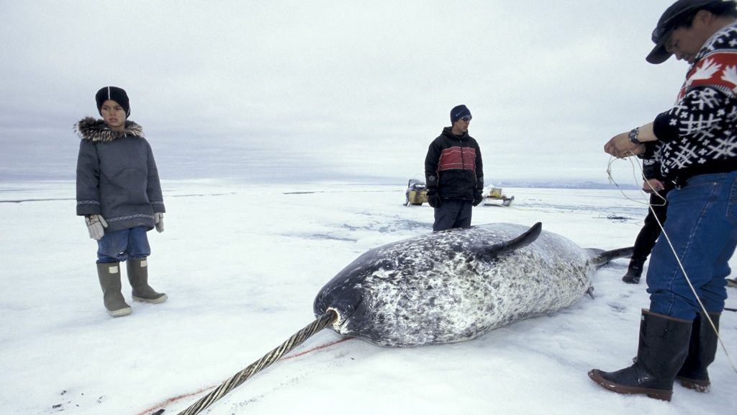
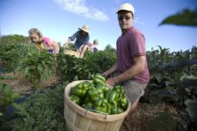
Where would you get your food in hong kong?
Correct, most people in Hong Kong will buy their food at a supermarket or market.
There is fishing, but most people don’t hunt wild animals in Hong Kong for food.
← Market
← Hunting
Not likely. Most people don’t go to farms to pick up their groceries.
Good guess! However, most people don’t travel to the farm!
← Farm
← Market and Farm

Slide 10
Supermarkets and Markets
Why do people buy their food in supermarkets and markets?
Hong Kong is a very big city which has to feed millions of people. In order to do this quickly, supermarkets make it easy for people to buy all they need in one place.
Also, because Hong Kong is so international, many people look for food brought in from different countries. For example, you would never find maple syrup here if it weren’t for supermarkets!
How far from your home is the supermarket?
How often do you go to the supermarket?

Slide 11
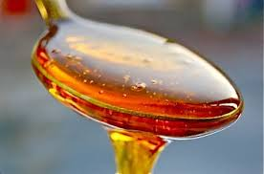
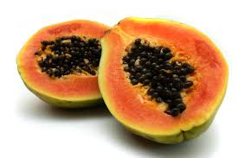
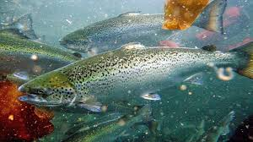
What food would you buy in hong kong?
Blue is a great colour! However, it isn’t Mr. Pakosh’s favourite! Try again!
Blue is a great colour! However, it isn’t Mr. Pakosh’s favourite! Try again!
← Rice
← Maple Syrup
Blue is a great colour! However, it isn’t Mr. Pakosh’s favourite! Try again!
Blue is a great colour! However, it isn’t Mr. Pakosh’s favourite! Try again!
← Papaya
← Fish

Slide 12
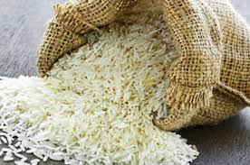
Trick question!
Why could you buy rice, papaya, maple syrup, and fish in Hong Kong?
Hong Kong is full of people from all over the world. Therefore, there is food from all over the world. Since Hong Kong has so many people, and so little farmland, all food has to come in from different places anyway! We have a lot of choice here!
What about in the past?
In the past, the Hong Kong diet was much more simple. Given it’s proximity to China and water, the staple diet was made of fish and rice. There was also a lot of fruit in the diet.

Slide 13
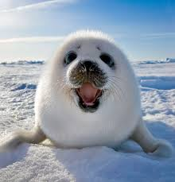
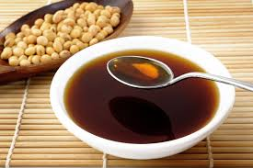
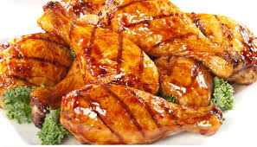
What would you not buy in hong kong?
Yes, you would! You can find noodles in many different foods in Hong Kong!
There are no seals in Hong Kong! Also, most people only eat seals out of necessity. Hong Kong has enough food that we don’t need to hunt.
<- Noodles
<- Seal
Soya sauce is everywhere! It’s a great addition to rice! Don’t add too much!
Chicken is a very popular meat in Hong Kong!
<- Soya Sauce
<- Chicken

Slide 14
Seal? Why Not?
Why would we not eat seal?
Seals live along cool ocean coasts and are usually hunted for their fur. They are rarely eaten except by certain communities, like the Inuit who need to eat them to survive!
Many animals aren’t consumed for their meat. However, in communities where growing food is impossible, these animals are their only chance to survive!

Slide 15
Zimbabwe

Slide 16
Which photo shows the temperature in zimbabwe?
It never snows in Zimbabwe! It definitely isn’t this cold!
It is sometimes cool, but usually heats up during the day! Guess again!
← Freezing
← Cool
It does feel like your melting sometimes, but is never too hot to make a desert!
← Warm
← VERY HOT!

Slide 17
Zimbabwe is warm!
Why is Zimbabwe warm?
Zimbabwe is close to the equator which means that it receives more sunlight and warmer temperatures in comparison to other communities farther south (I say south because it south of the equator).
Why is temperature important to food?
Temperature helps decide what food can be grown (farms) in one area. With warm temperatures, it is possible to grow many different types of food, like rice, fruits, and vegetables. It is also good for keeping animals for food, like chickens, sheep and cows.

Slide 18
Which photo best shows Zimbabwe’s land?
Of course! Hong Kong is very mountainous! This makes farming difficult!
Yes! There is a lot of farmland in Zimbabwe. They grow a lot of their own food.
← Mountains
← Farmland
Getting close! We live in a warm and humid place, but we still live on solid ground…unlike wetlands!
In the Tundra, it is difficult for plants to grow because of the cold. Zimababwe is not cold, and it has a lot of plants!
← Wetlands
← Tundra

Slide 19
Zimbabwe is Full of farmland!
Why is land important to food?
Although some parts of the country are mountainess and dry, there is a large amount of space for farmland.
In an area full of farmland, there is lots of soil to grow plants to help make food for the population. Wotj farmland, you will usually rear (take care of) cattle, chickens, and pigs for meat. You can even use the food you grow to feed these animals.

Slide 20
Where would you get food in zimbabwe?
Almost! Many people in Zimbabwe shop at the markets, but some people get their food from other places as well.
Not really. Some people do hunt, but it is rarely in order to survive. Try again!
← Market
← Hunting
Almost! Many people in Zimbabwe shop at the markets, but some people get their food from other places as well.
BINGO! Depending on whether you live in cities or in the country, people will get their food from either a market or farm.
← Farm
← Market and Farm

Slide 21
Markets and farmland
Why do people get their food from markets and farms?
Zimbabwe is a large country with many different areas. In a big city, like Harare (the capital), people will most often shop at markets for their food. However, when you travel outside of large cities, more people will be growing their own food. Even more people will grow some food and buy certain products at the markets as well. Some people in small communities have to walk for hours to get to a market to buy things.
How far from your home is the supermarket?
How often do you go to a farm for food?

Slide 22
What food would you buy in Zimbabwe?
Nice try! Although you could get rice at a supermarket, it is not a primary type of grain. Zimbabwe isn’t wet enough to grow it.
Nope! It would be rare for local people to have ever tried maple syrup. It would be available in large cities.
← Rice
← Maple Syrup
Zimbabwe is landlocked (does not touch any oceans). Therefore, apart from some fish in rivers and lakes, it is not a main food for people in Zimbabwe.
BINGO! With it’s warm weather, papaya grows easily and many people enjoy eating this delicious fruit.
← Papaya
← Fish

Slide 23
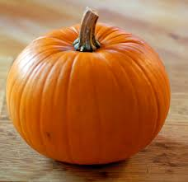
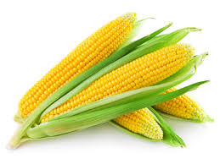
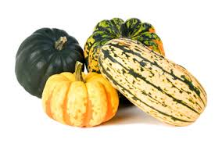
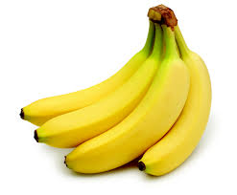
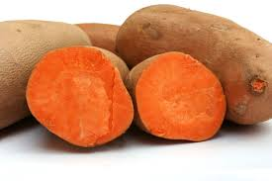
That’s right! Papaya!
Why would you buy papaya in Zimbabwe?
Since the weather is warm, and there is plenty of space, many farmers will grow this food and sell it. People can then buy this food at markets.
What else do people eat in Zimbabwe?
There are many different kinds of food that people in Zimbabwe can eat which is grown in their country. Some include: pumpkin, corn-on-the-cob, squash, mango, bananas, peas, carrots and sweet potatoes.
Sweet potatoes is one of the main dishes eaten in Zimbabwe because it is both delicious and nutritious!

Slide 24
What would you not buy in Zimbabwe?
Yes, they do eat and keep goats! They’re great for meat and milk!
Correct! Zimbabwe doesn’t have access to any ocean so it is rare for people to eat any type of food from the ocean.
← Goats
← Seal
Soya sauce is everywhere! It’s a great addition to rice! Don’t add too much!
Chicken is a very popular meat in Zimbabwe! They also give people eggs!
← Sweet Potatoes
← Chicken

Slide 25
Seal? Why Not?
Why would they not eat seal?
Seals live along cool ocean coasts and are usually hunted for their fur. They are rarely eaten except by certain communities, like the Inuit who need to eat them to survive!
Many animals around the world aren’t consumed for their meat. In a place like Zimbabwe, where you can grow food, hunting of local animals for their meat is rare.
Also, there are no seals in Zimbabwe! It doesn’t touch the ocean!

Slide 26
Arctic Canada (the Inuit)

Slide 27
Which photo best shows temperature in arctic canada?
Try again! It is often cool in the summer, but they still have quite cold nights.
← Freezing
← Cool
Nope! It is never very hot in the arctic! However, with climate change, temperatures are rising.
It is rarely warm in the Arctic because of how close it is to the North Pole.
← Warm
← VERY HOT!

Slide 28
BRRRR! It’s cold in here!
Why is Arctic Canada cold?
Arctic Canada, where the Inuit live, is very close to the North Pole. The closer you are to either of the poles (North or South), the colder it will be. For months at a time, they won’t even have sun for more than a couple of hours a day!
Why is temperature important to food?
Temperature helps decide what food can be grown (farms) in one area. With freezing temperatures, it is impossible to grow food since there is a permafrost (frozen soil, even in summer). Therefore, you will rarely see many plants except for some small brush.

Slide 29
Which photo best shows the Arctic’s land?
Good guess! There are many snow covered mountains in the north, but most of the land is flat or made of sea ice.
Nope! It is much too cold to grow any food in the Arctic!
← Mountains
← Farmland
Nope! There are no wetlands as the water would be too cold for plants to grow! Try again!
In the Tundra, it is difficult for plants to grow because of the cold. Hong Kong is not cold, and it has a lot of plants!
← Wetlands
← Tundra

Slide 30
ArCtic Canada is the Tundra!
Why is land important to food?
The land on which we live helps decide what food can be grown. In the tundra, there is soil but it is frozen year round. This makes it difficult to dig below 10 cm. Therefore, it is difficult to grow plants which make it impossible to grow food to help everyone who lives here survive!

Slide 31
Where would you get your food in the arctic?
Nice try! People live in very small communities! This makes having a market very difficult to run!
Good guess! In the past, this was true. Now, it is a tad different.
← Market
← Hunting
Definitely not! There are no farms to get food from unfortunately!
Good guess! However, most people don’t travel to the farm!
← Farm
← Market and Hunting

Slide 32
Supermarkets and Hunting!
Why do people get their food in supermarkets and from hunting?
In the past (before 1950), most people would only survive by hunting local animals. However, with a great connection with southern Canada, some communities now have markets in which products are brought in by plane or boat.
No communities in the Arctic are connected by roads. They are very isolated (alone). Some communities still only hunt for survival.
How far from your home is the supermarket?
How often do you go hunting?

Slide 33
What food would you eat in the arctic?
Nice try! However, there are no maple trees in the Arctic. There are no trees above the Arctic circle. It could be bought at a market, but it would be expensive.
Nice try! Although you may be able to buy this in a market, it cannot be grown. Therefore, it is rare to eat.
← Rice
← Maple Syrup
Definitely not! This is a very rare fruit not only for the Arctic, but all of Canada. It is much too cold to grow here!
Blue is a great colour! However, it isn’t Mr. Pakosh’s favourite! Try again!
← Papaya
← Fish

Slide 34
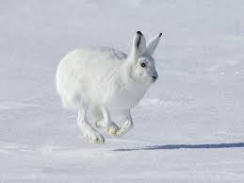
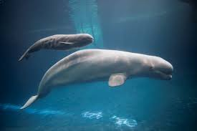
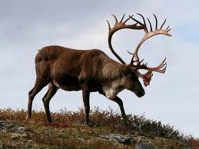
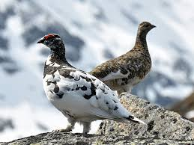
Fish! Of course!
Why would you get fish for food in the Arctic?
The Inuit have hunted and fished for 100s of years! The Arctic Ocean surrounds their communities and provides a great source of food for the communities! They even fish through the ice by digging a hole in it and catching them beneath the ice (ice fishing).
What else would you eat in the Arctic?
Since they cannot grow food in the Arctic, the Inuit have been primarily eating food that they can hunt. This includes: seals, musk ox, ptarmigan, caribou and whales.

Slide 35
What would you not eat in the arctic?
Try again! Seal is eaten all the time by both animals and humans. It is often eaten raw! Yum!
← Goats
← Seal
Whales, such as the Beluga, are a very important source of food. One Beluga Whale can feed up to 100 people in a community.
Ptarmigan are still hunted! They are similar to chickens in the design and meat.
← Whale
←Ptarmigan

Slide 36
Goats? Why Not?
Why would they not eat goat?
There are no goats in the Arctic! It is much too cold for them to survive! Also, if people were to bring goats to the Arctic, there is no vegetation that they could eat to survive.
What else would you not eat in the Arctic? Why?

Slide 37
Now, let’s see how much you remember! Have a seat!

